Slide 1
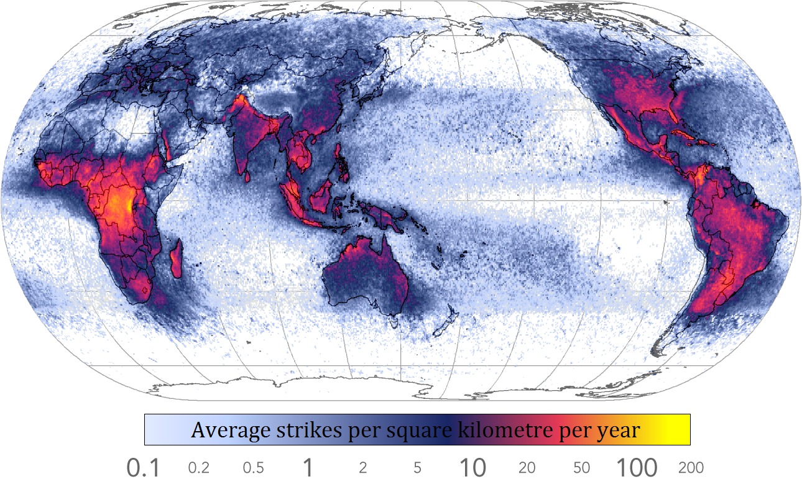
Text Mining: Energy Disaster Incidents Verisk Analytics Capstone Project
M.S. Data Science: gU5, University of New Haven

Slide 2
Agenda
Motivation
Introduction
Data Handling
Data Extraction
Examples
Conclusion
Notes:
The goal is to give audiences the sense of understanding what I did in company I worked for which is about data handling and data extraction

Slide 3
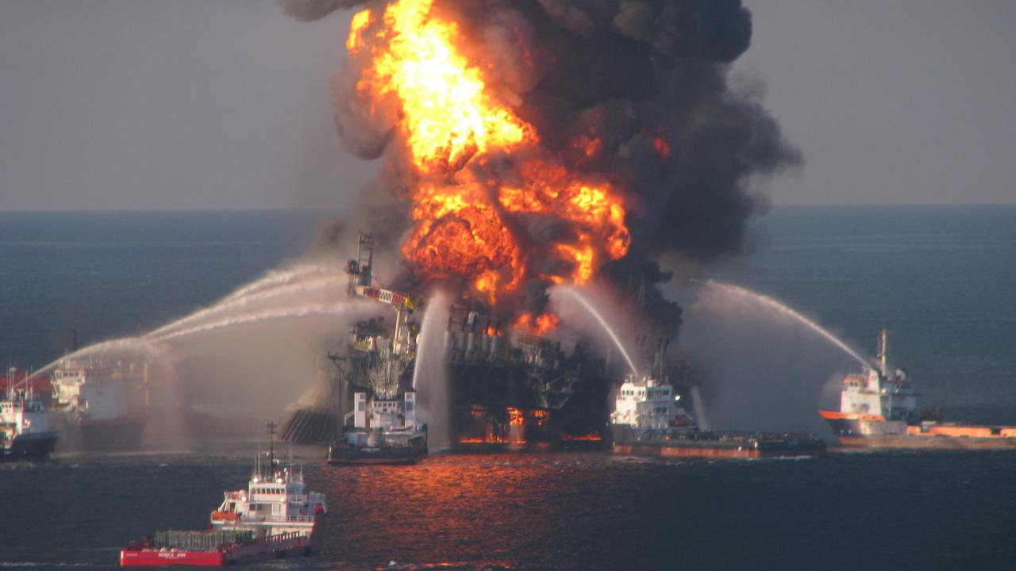
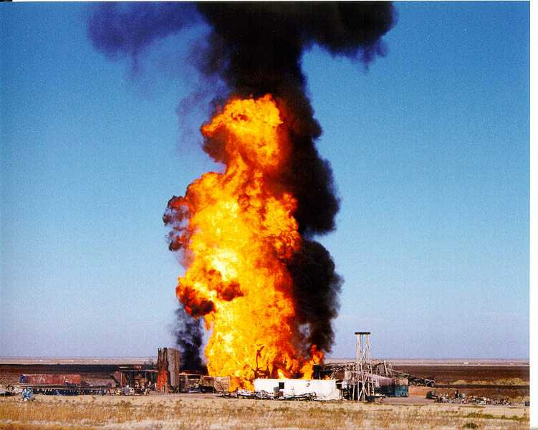
1. Motivation
OIL SPILL
GAS EXPLOSION
Notes:
Many businesses in the energy industries right now are really aware of potential energy incidents such as Oil spills and gas explosions ||||| they cause the tremendous loss for business owners ||||||
These happen unexpected which mean we don’t know when it will happen.
To measure the level of risk, many insurance underwriters prefer having some ideas of what incidents are likely or about to happen so that they can migrate a preparation plan or BIA Those incidents sometimes happened unexpectedly and hard to be predictable

Slide 4


Verisk Analytics:
Collecting comprehensive history of disasters/accidents/incidents.
Building a business intelligence database from collected data.
Business X
Insurance Underwriters
Business D
Business C
Business A
Business B

Slide 5
Introduction to Project Process
Milestone 1
Milestone 2
Milestone 3
Milestone 4
Phase 1
Data Research
Phase 2
Data Handling
Phase 3
Data Extraction
Phase 4
Structure Database
Notes:
The project was subsidized into 4 parts each is corresponded to each milestone. And I was specialized for data handling and data extraction

Slide 6
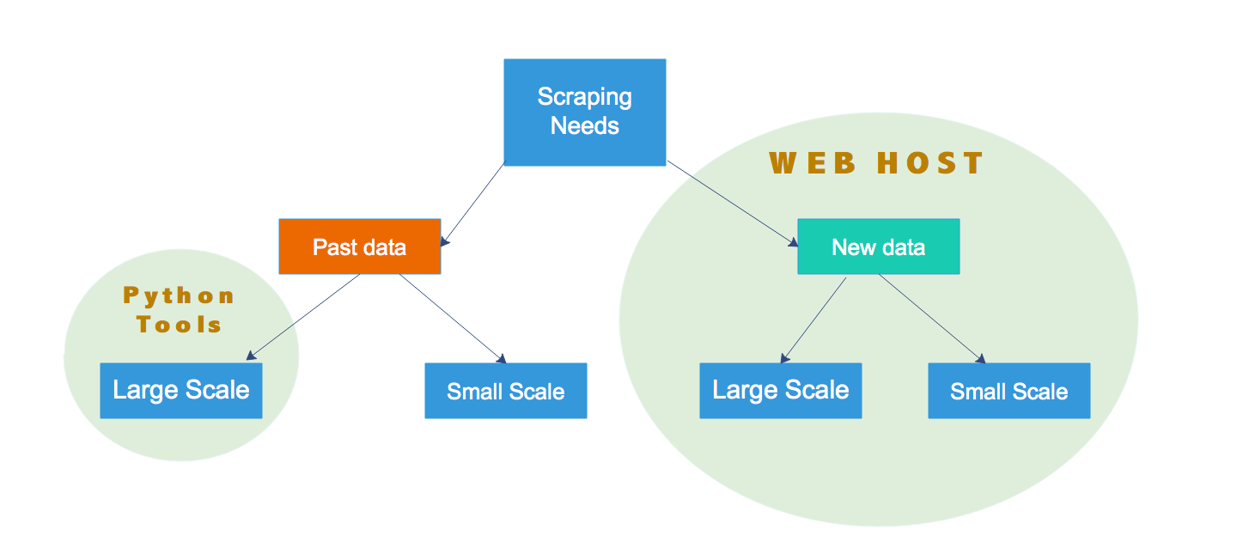
Approach to Data Handling
Notes:
Change the graph

Slide 7
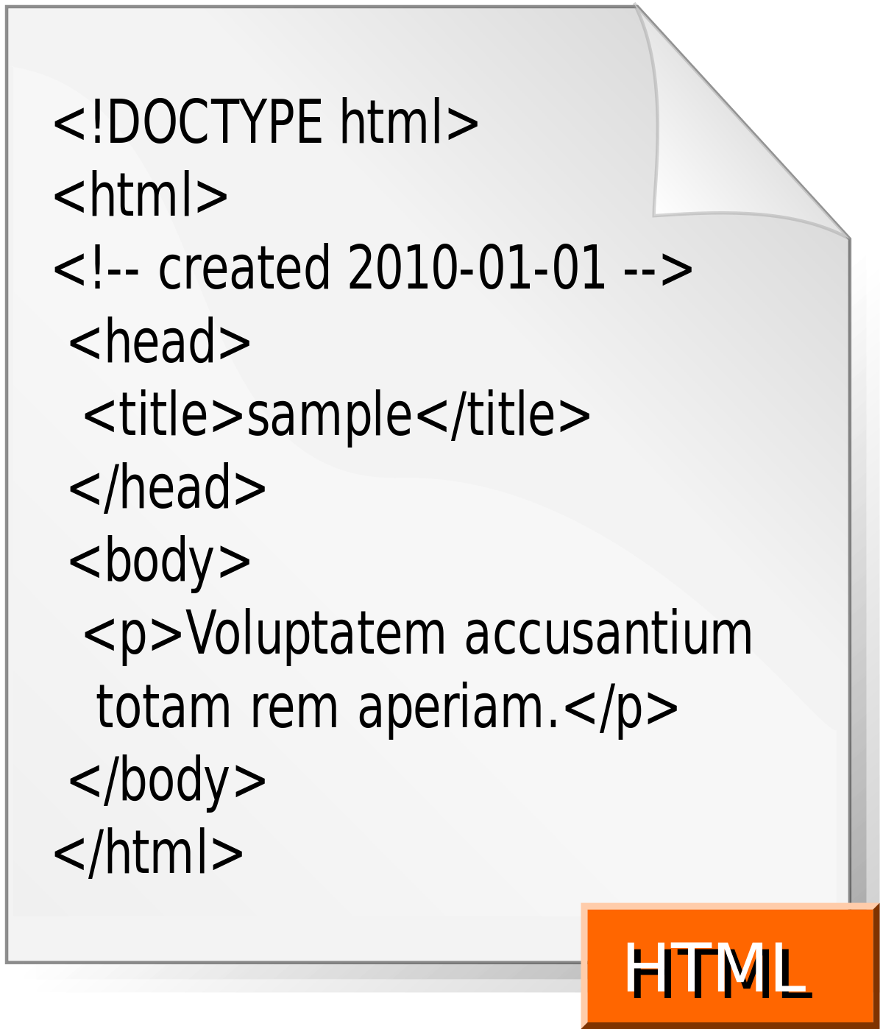





Python Tools for Data Handling
BeautifulSoup
PDFMiner
Pandas
Notes:
Pop up panda

Slide 8
Data Extraction Process
Target the interest metrics and the corresponding values
RegEx .
Files
File handling
Scraping data
.pdf
.html
.xlsx
PDFMiner
BeautifulSoup
Pandas

Slide 9
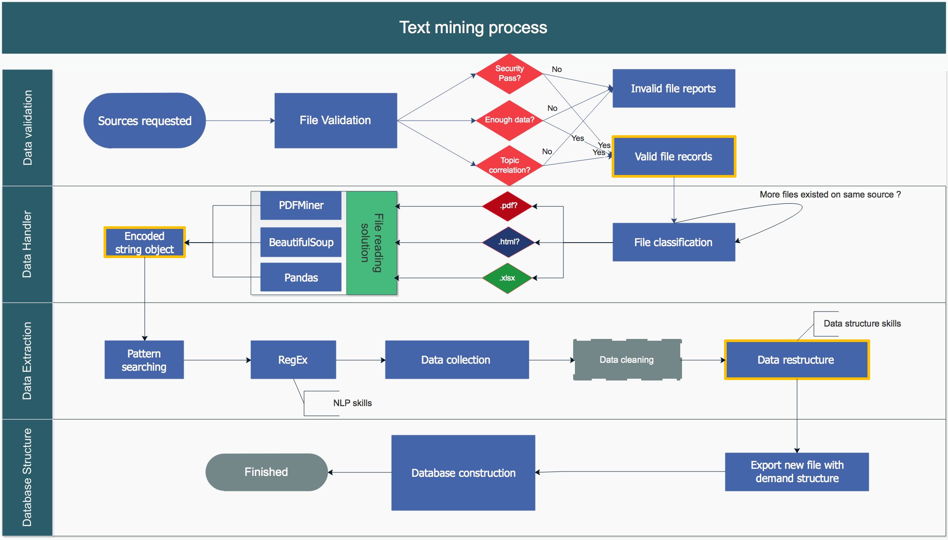

Slide 10

Notes:
Change color for phase 2 and 3

Slide 11
EXAMPLES

Slide 12
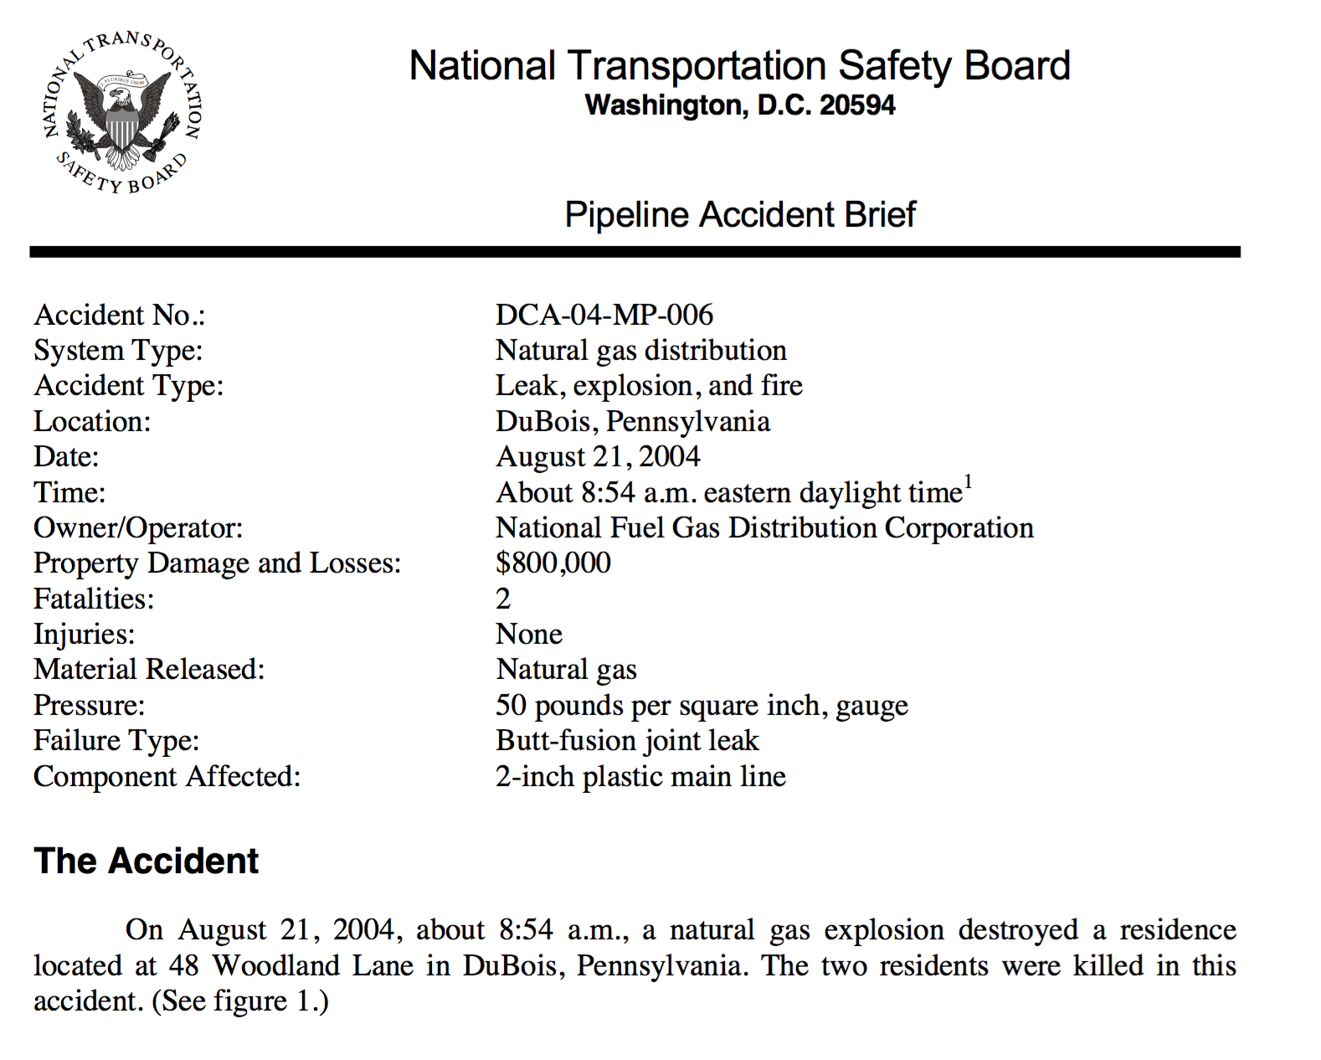
Solution for Sample PDF file:
Metrics
Cause of Loss
State
Date of Incidence
Owner/Operator
Loss estimated ($)
Injury
Death
Text
Values[0]
Leak, explosion,..
DuBois, Pennsy,…
2004-21-08 8:54:00
National Fuel Gas Dist
800,000
2
0
On August 21, 2004, about ….

Slide 13
Metrics
Cause of Loss
State
Date of Incidence
Owner/Operator
Loss estimated ($)
Injury
Death
Text
Values[0]
Leak, explosion,..
DuBois, Pennsy,…
2004-21-08 8:54:00
National Fuel Gas Dist
800,000
2
0
On August 21, 2004, about ….
Values[1]
Mechanical Failure
NY
2006-22-12 00:00:00
Unknown
200,000
0
2
On December 22, 2006, abo ...
Values[2]
Technical Failure
TX
2008-01-07 8:54:00
UNK
100,000
33
1
On July 01, 2008, about ….

Slide 14
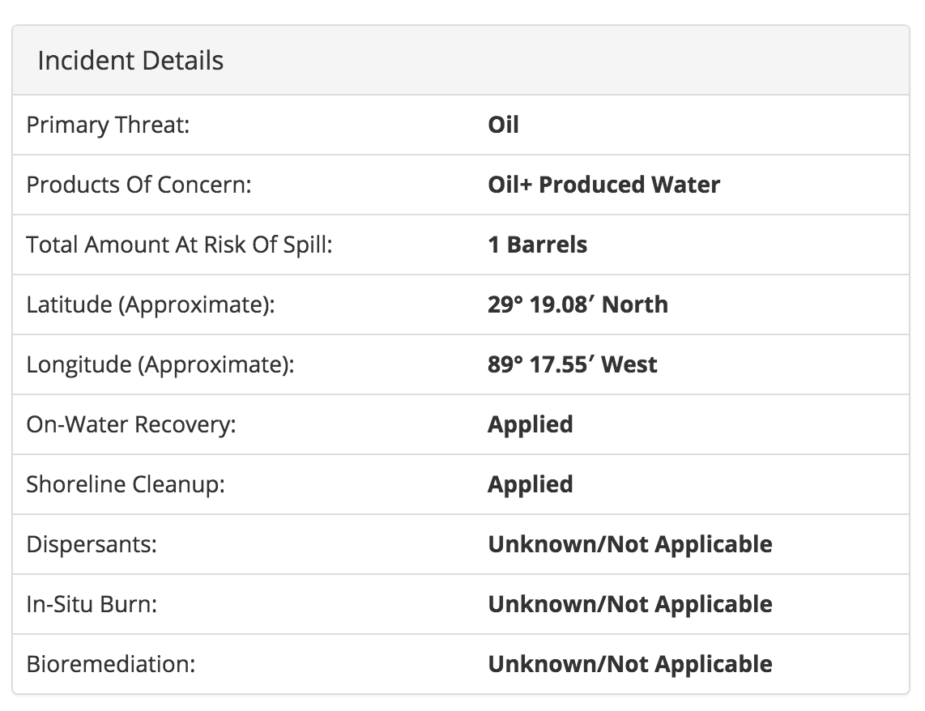
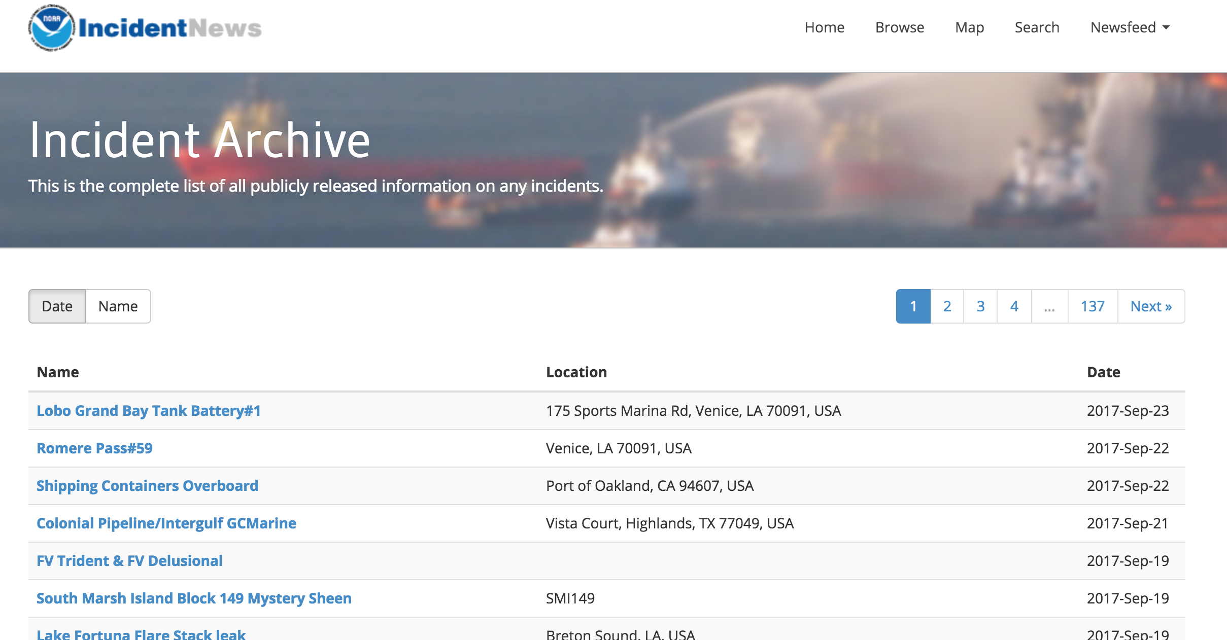
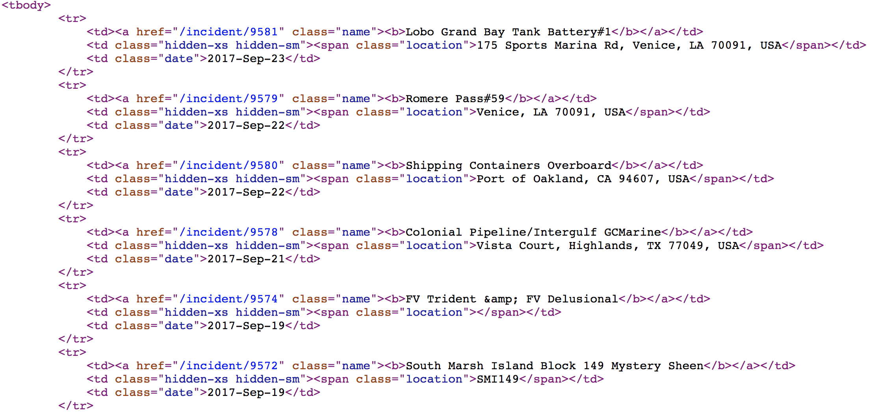
Sample Solution for HTML:

Slide 15
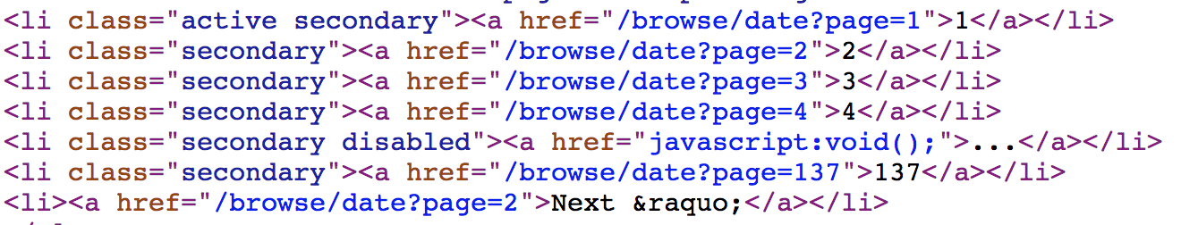
Sample Solution for HTML:

Slide 16
Sample Solution for HTML:
Incident Links
”/browse/date?page=1“
”/browse/date?page=2“
”/browse/date?page=3“
…
”/browse/date?page=137“
1
…
137
Prefix = ”/browse/date?page=“
+

Slide 17
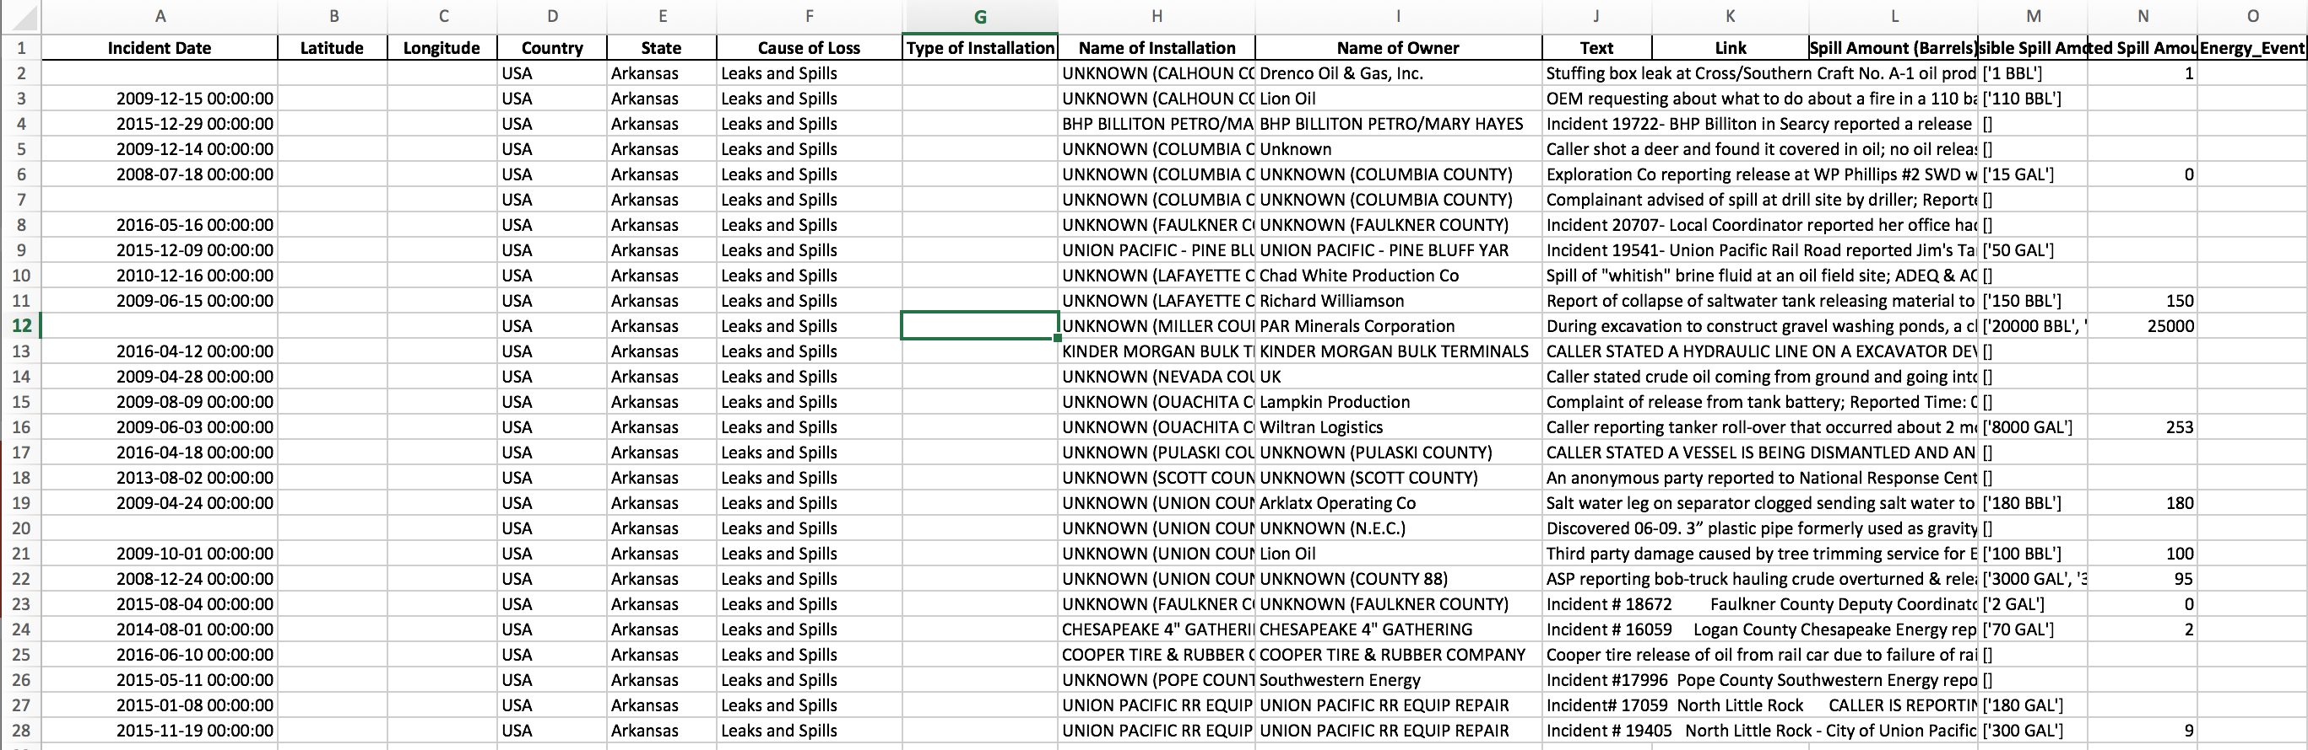
Table of Results:

Slide 18
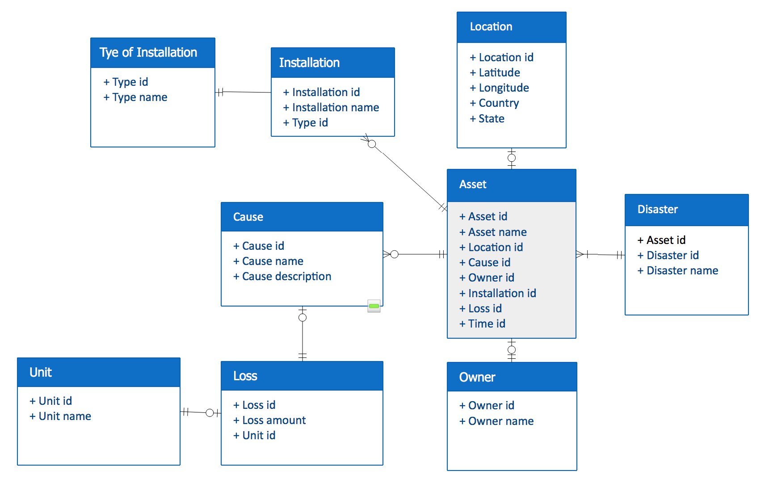
Database Infrastructure Construction:

Slide 19
Conclusion:
More than 35,000 data rows collected!
Developed Successful Workflow Paradigm: Data Research, Handling, Extraction, and Structuring of Database
Paradigm can be reused - although efficiently processing new data requires vigilant creativity (as data context varies with each new data source).
Successful database construction requires an innovative application of skills for: Source Validation, Natural Language Processing, and Database Structural Design

